Slide 1
WE HAVE #30 MILLION REASONS FOR EUROPEAN
ON RARE DISEASES

Slide 2
HOT TOPICS

Slide 3
HOT TOPICS

Slide 4
Our Advocacy Priorities

Slide 6
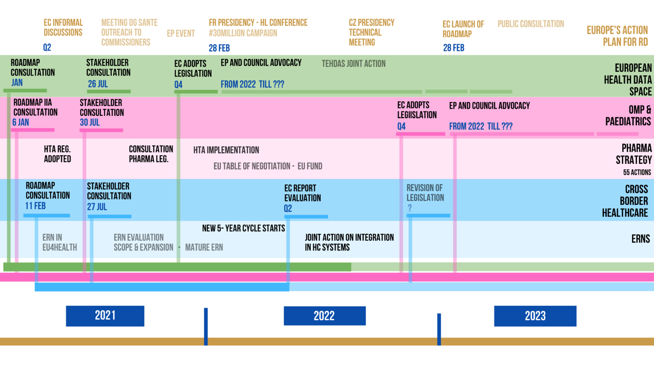

Slide 7
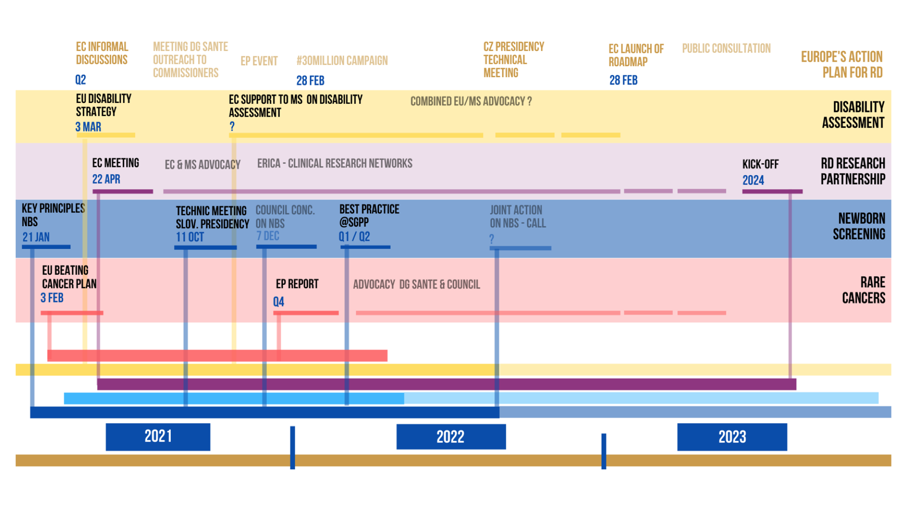

Slide 8
OUR ADVOCACY PRIORITIES FOR JANUARY-FEBRUARY 2022
FR PRESIDENCY – HL CONFERENCE
#30MILLION CAMPAIGN
European Health Data Space
EC adopts proposal for legislation in Q2 or most likely Q3 - Advocacy work then starts with EP and Member States (Council)
Development and Access to Treatments
Pharmaceutical Strategy - EC adopts proposal for new legislation on Orphan Medicinal Products and Paediatrics in Q4
HTA Regulation adopted in 2021. Implementation has started, focus on patient engagement in HTA
EU table of negotiation - EU Fund - specific initiatives under FRench Presidency
ERNs
CBHC directive, evaluation report expected in March
New 5-year cycle starts. Promoting the new vision for mature ERNs
Integration of ERN into national healthcare system, advocacy for a Joint Action to support Member States
Diagnosis
Newborn Screening
Social care, inclusion and and disability
Long term care strategy
Integrated care for PLWRD, upscale InnovCare and European Network of Resource Centres
Disability Assessment: Support to Member States

Slide 9
Your Advocacy Priorities

Slide 10
YOUR ADVOCACY PRIORITIES FOR 2022
What is your advocacy priority for the next months?
Are you able to integrate advocacy actions for the EU Action Plan into your RDD activities?
Have you sent a letter about the Action Plan to your National Authorities?

Slide 11
Action Plan Updates

Slide 12
Trio & French Presidency of the EU Council
“The aim of this high-level conference, in accord with the Presidency Trio, will be to put forward recommendations to further develop European regulations concerning rare diseases.
The conference will provide the occasion to define the EU roadmap for this matter and to collectively prepare to implement a European plan for rare diseases by 2030.”
What do we hope for?
First step towards EU Council Conclusions at the end of the French Presidency
Notes:
Trio
PFUE
Show draft agenda of HLC conf
Letter to MOH signaling this event
Additional Ministerial meetings mentioned below in key events
Mapping of other Min/rep - - share concept of Action Plan - esp CZ, SE, SP… but all
End of pres EU council conclusions
Key events
2 Europe RDD events (2 Parliamentary events)
What are your plans? Action Plan around RDD?
Grass roots deliverables
Video clip
Country from book

Slide 13
French Ministerial Conference: what can you do?
Your health ministers should have received an invitation
Template letter to send to health ministers to attend
Map other ministers and contacts & share the Working Proposal of an Action Plan with ministry contacts
Other events under the French presidency : Feb 8 - 9: EPSCO Council Stronger industry; Resilience of Health Systems to Support Cooperation; Towards an independent, competitive and innovative European healthcare sector; “Citizenship, ethics and health data”; Market Surveillance for Medical Devices; In Vitro Diagnostic Medical Devices

Slide 15
Rare Disease Day events
Two European Parliament events:
15 February 2022: “How can Europe advance rare disease innovation”
co-organised by EURORDIS, Biogen and MEP40. MEP Moretti
1 March 2022: “How a new European plan can help children living with rare diseases”
proposed by MEP Vautmans as part of the Intergroup on Children, including a screening of the film “Save Sandra”
What have you got planned?

Slide 16
Best Practices

Slide 17
BEST PRACTISES OF HOW EXISTING INEQUALITIES FACED BY OUR COMMUNITY HAVE BEEN REDUCED
At the next European Conference on Rare Diseases (ECRD 2022), during the conference sessions of Goal 2: "Reducing inequality within and among countries by focusing on equity for PLWRD", we wish to showcase best practices of how existing inequalities faced by our community have been reduced.
We would be interested in your suggestions on the following topics:
1. Good practices in integrated care, case management and/or holistic care: this could be an example of your Member State competent authorities (Ministry of Health & Social Care) adopting a national policy or strategy to promote greater integrated / holistic care; or you may know of a service provider who is seen as a leader in delivering integrated care.
2. Good practices in supporting a child or young adult to access education: we would be interested if you have any national best practice in education due to innovative teaching approaches or national policy or strategy.
3. Good practices in tackling discrimination in the workplace: any policy, legislation, project or initiative that support greater empowerment for people with a rare disease or a disability in accessing work OR support greater independent living through technologies, infrastructures, practice and policies.

