Slide 1
UN Resolution on addressing the challenges of persons living with a rare disease and their families
-
Clara Hervas
Notes:
CH

Slide 2
In this presentation
UN campaign overall status
Resolution4Rare Toolkit & Dear UN initiative
Next steps towards adoption

Slide 3
Why a UN Resolution at the UN General Assembly in New York?
The impact of going through life with a rare disease goes far beyond only health concerns, and affects the whole family.
Persons living with a rare disease and their families experience stigma, discrimination, and lack of visibility and recognition in society.
Not a Resolution on rare Diseases…
A Resolution on addressing the challenges of persons living with a rare disease and their families

Slide 4
A contribution towards the Sustainable Development Goals
The motto “leave no one behind”, at the core of the UN Agenda 2030 Sustainable Development Goals, is fit for purpose for persons living with a rare disease
Their challenges need to be addressed in order to meet these SDGs:
Notes:
CH

Slide 5
5 key asks

Slide 6
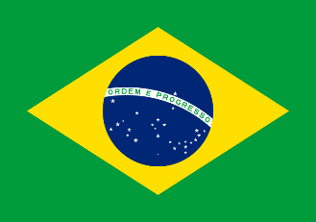
Core group of Member States
Brazil
Qatar
Spain
Monthly working meetings since March 2021
Co-organised side-events to gather support from other UN Member States
Presented ‘zero draft’ of UNGA Resolution on 16th Sept
Leading negotiations on the draft with other UN Member States (29 Sept, 11, 15, 19 Oct)
Will table the Resolution under ‘social development’ agenda item 28 of the Third Committee of the UNGA
Notes:
CH

Slide 7
Outreach to other UN Member States
In parallel:
Top-grass: Working with the Core Group
Grassroots: Resolution4Rare campaign RDI team and RDI/EURORDIS members
Top-grass
Grassroots

Slide 8
UN HLPF Side event 7 July
ON THE ROAD TOWARDS COVID-19 RECOVERY & DELIVERY OF THE SDGs
ADDRESSING THE CHALLENGES OF PERSONS LIVING WITH A RARE DISEASE AS A
HUMAN RIGHTS, SUSTAINABLE DEVELOPMENT AND EQUITY PRIORITY

Slide 9
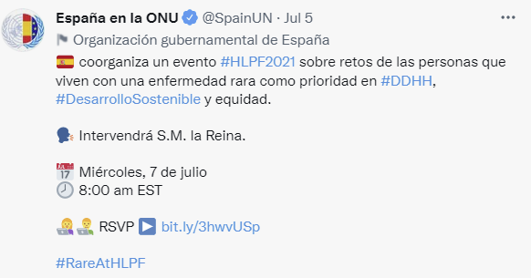
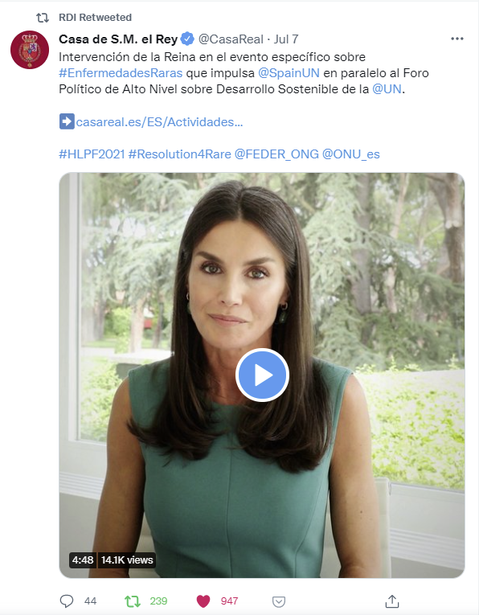
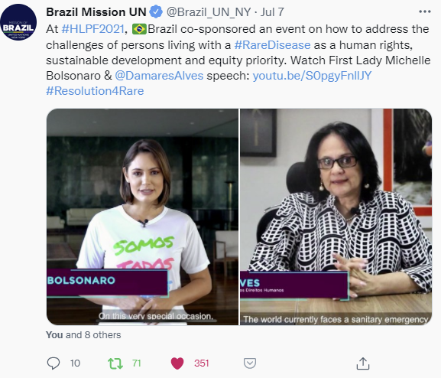
HIGH-LEVEL SIDE-EVENT AT THE HIGH-LEVEL POLITICAL FORUM 2021
300 participants from 61 countries:
Permanent Missions to the UN: 16
Government officials: 8
Civil Society: 171
Private Sector: 28
Academic: 33
Health professional: 28
Consultant: 6
Foundations: 3
Media: 4
UN agency: 1
Care worker: 2
Other: 6

Slide 10
6 UN REGIONAL GROUP MEETINGS 7-9 SEPTEMBER – 32 Member States attended
UN RESOLUTION ON PERSONS LIVING WITH A RARE DISEASE AND THEIR FAMILIES

Slide 11
First Informal Consultation – 84 Member States attended
UN RESOLUTION ON PERSONS LIVING WITH A RARE DISEASE AND THEIR FAMILIES
Such a high attendance is “unheard of”
General support and constructive comments.
14 Member States made supportive oral remarks, including Czech Republic, Denmark, France, Italy, Russia, Switzerland, United Kingdom.
Opening to early “co-sponsorship”
Next consultations: 11th, 15th and 19th October – aiming for consensus and wide co-sponsorship by then

Slide 12
10 UN Member States have formally declared their support
Argentina
Colombia
France
Ireland
Italy
Japan
Kuwait
Malta
Peru
Thailand
Notes:
CH

Slide 13
43 other UN Member States engaged
In contact with RDI secretariat
or RDI/EURORDIS members:
Austria
Belgium
Botswana
Burkina Faso
Czech Republic
Estonia
Ghana
Luxembourg
Morocco
New Zealand
Romania
Senegal
South Africa
Sweden
United Arab Emirates
Uruguay
USA
Attended UN Regional Meetings on the UN Resolution and/or First Informal Consultation:
Algeria
Andorra
Brunei Darussalam
Cuba
Denmark
Dominican Republic
Egypt
El Salvador
Greece
Hungary
Indonesia
Israel
Lesotho
Mexico
Nauru
Paraguay
Portugal
Russia
Saint Vincent and the Grenadines:
Saudi Arabia:
Singapore
Switzerland
Turkey
United Kingdom
Venezuela
Vietnam
Notes:
CH

Slide 14
EU Member States – status
Countries
Austria – NA in contact | Italy – supportive / asking co-sponsorship
Belgium – reply to NA pending | Latvia
Bulgaria | Lithuania
Croatia | Luxembourg – reply to NA pending
Cyprus | Malta – supportive / asking co-sponsorship
Czech Republic – NA in contact/ asking co-sponsorship | Netherlands
Denmark – supportive remarks at consultation | Poland
Estonia – NGO Committee for RDs in contact | Portugal – attended Regional Meeting
Finland | Romania – reply to NA pending
France – supportive / asking co-sponsorship | Slovakia
Germany – reply to NA pending | Slovenia
Greece – reply to NA pending | Spain – Supportive/ Main Sponsor
Hungary - attended Regional Meeting | Sweden – NA in contact
Ireland – supportive / asking co-sponsorship

Slide 15
Member States in key groups at the UNGA
Supportive Member States can be champions and have influence over other group members:
EU DELEGATION (27) (France, Estonia, Ireland, Italy, Malta, Spain)
GROUP OF AFRICAN MEMBER STATES (54) (Burkina Faso, Ghana, Morocco, Senegal, South Africa)
GROUP OF LATIN AMERICAN & CARIBBEAN STATES (32) (Argentina, Colombia, Peru)
GROUP OF SMALL DEVELOPING ISLAND STATES (52) (Malta – co-chair)
GROUP OF GULF COUNTRIES (6) (Kuwait, Qatar, United Arab Emirates)
GROUP OF FRIENDS OF UHC (7 co-chairs) (Japan, Thailand, France)
GROUP ON FOREIGN POLICY AND GLOBAL HEALTH (7) (France, Brazil, Senegal, South Africa)

Slide 16
The Resolution4Rare Toolkit
Toolkit featuring regular and new uploads every month including:
Letter templates to send to policy makers: Ministry of Health, Social Affairs or Foreign Affairs/Permanent Missions to the UN
Concept Notes to help you talk about it
Factsheet
Posts, images and GIFs to spread the word on social media using the hashtag #Resolution4Rare
Notes:
CH

Slide 17
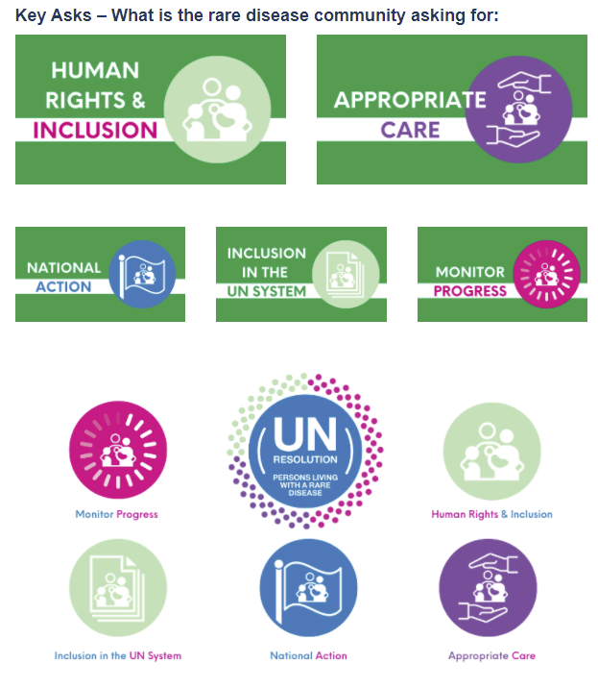
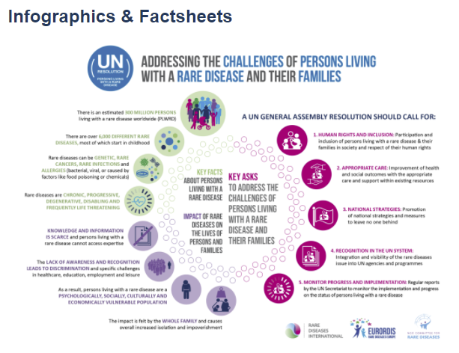
The Resolution4Rare Toolkit
Notes:
CH

Slide 18
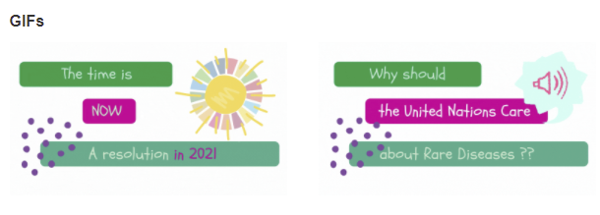
The Resolution4Rare Toolkit
Video: What is a UN Resolution and why does the global community need it
Notes:
CH

Slide 19
‘Dear UN’ initiative
Notes:
CH

Slide 20
“What impact would a UN Resolution
have on the global community?”

Slide 21
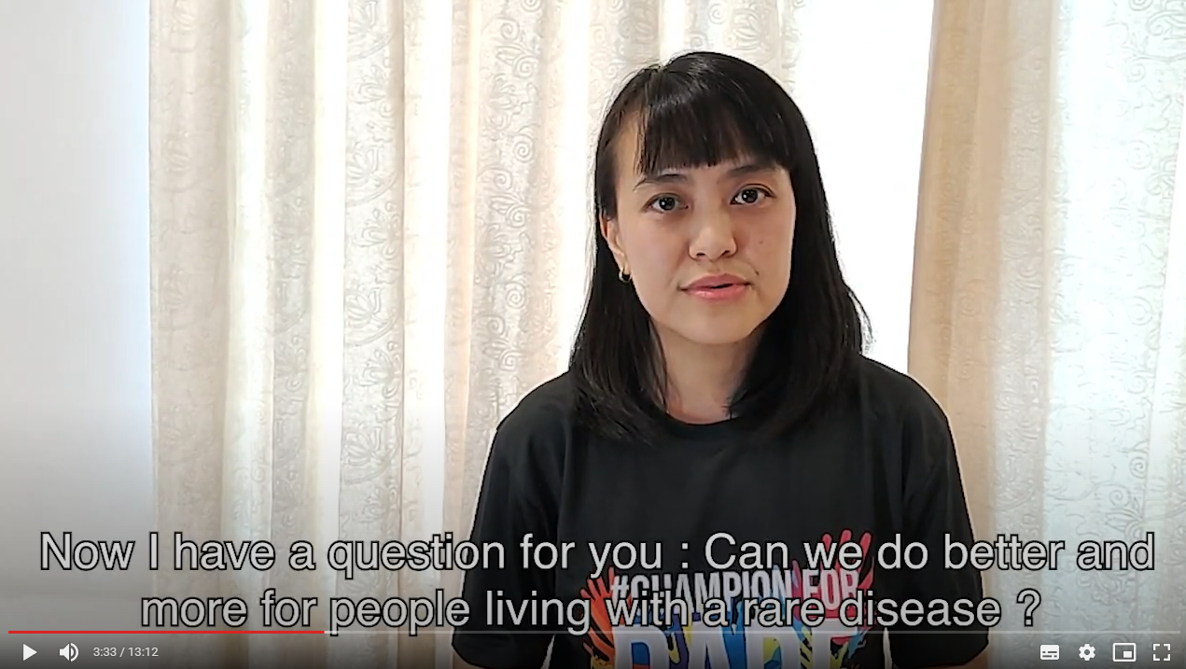
‘Dear UN’ initiative
More than 40 testimonies received and 17 selected for video from: Argentina, Brazil, Belgium, Germany, Ireland, Kenya, Kuwait, Latvia, Malaysia, Uganda, Zimbabwe
Notes:
CH

Slide 22
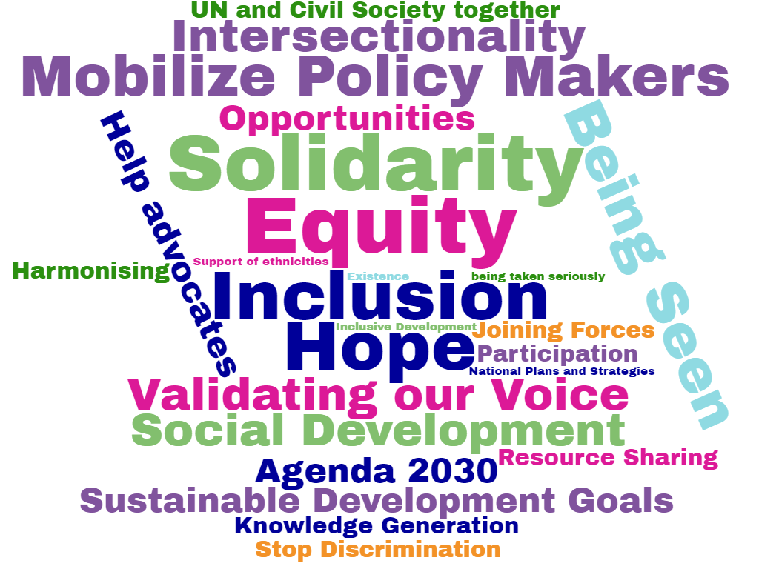

Slide 23
Next steps towards adoption
November 2020 – Q1 2021
Q2 2021
Q 3 2021
Q4 2021
Community Consultation & campaign
Civil Society proposal of UN
Rare Disease Day
RDI Policy Event
(4 March)
Launch of the toolkit
Grassroots Resolution4Rare campaign
& Dear UN Initiative
Targeted adoption of Resolution
by the UNGA (December 2021)
UN Member States support
Mapping and Meetings of Supportive UN Member States
HLPF side-event
(7 July)
UN Regional Groups meetings
(7-9 Sept)
Zero draft shared by Core Group (16 Sept)
Informal Consultations (29 sept, 11, 15, 19 Oct)
3rd Committee takes action on proposals
(5-19 Nov)
Core group of Member States is formed
Increase number of Supportive UN Member state by relevant geographic & economic & political UNGA groups

Slide 24
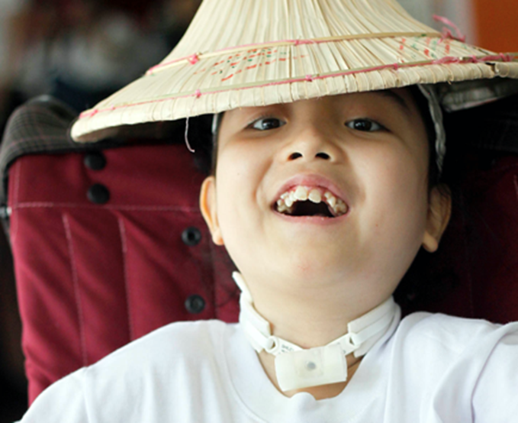
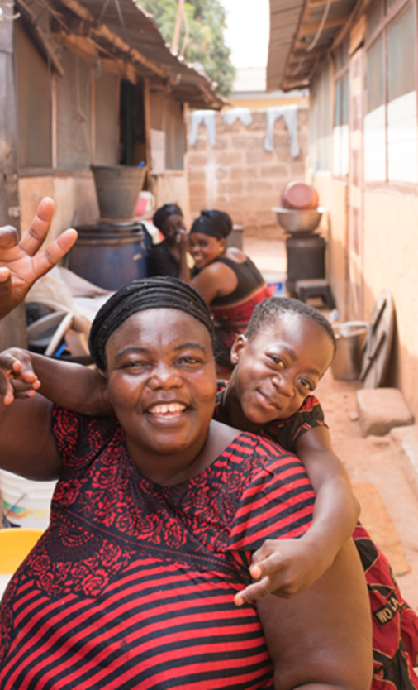
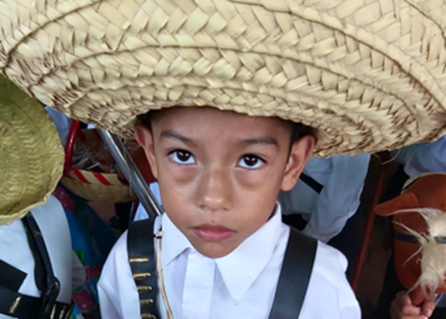
THANK YOU!

